Slide 1


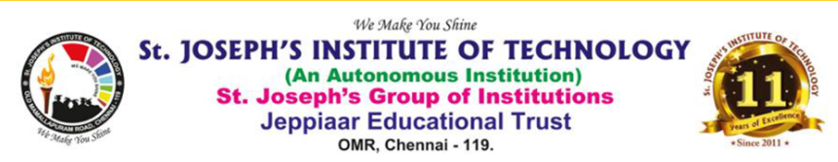
Bank of Baroda Hackathon - 2022
Technology Partner
Your Team Name: STAR TECHIES
Your team bio :Shift the ctrl to us,we will alt the world!!!!!!
COLLEGE NAME:ST.JOSEPH’S INSTITUTE OF TECHNOLOGY

Slide 2
Problem Statement?
Why did you decide to solve this Problem statement?
To reduce the service problems in the bank , this domain is a much needed technology to solve this complication.
Using this technique the security and standardizations of the bank can be made better.
As it easily deals with customers’ emotions, this technique would be highly beneficial to both bank and the customers.
Most of the models are trying to solve emotion detection problem but we can be more accurate which will improve the service .

Slide 3
User Segment & Pain Points
Which user /advertiser segment would be early adopter of your product & why?
If customer covers his/her face , then the accuracy of the detection becomes to a lesser degree.
But we assure that this flaw will soon be sorted out by us .
We are currently not dealing with the process of differentiating gender among the people , we will soon work on it and fix it.
The advertiser (Bank of Baroda) would be the early adopter of our model.
Our project would also be helpful to all sectors that is in need of 24*7 CCTV surveillance.

Slide 4
Pre-Requisite
What are the alternatives/competitive products for the problem you are solving?
Many video analytics model has provided various solutions for this problem statement.
The establishments that are competitive to us have previously put forth the way of solving the problem.They are:
Software as a Service (Saas)-based facial recognition engines
Self-Hosted REST API solution
Ageitgey/face_recognition

Slide 5
Azure tools or resources
Azure tools or resources which are likely to be used by you for the prototype, if your idea gets selected At first,we are planning to train our system using Machine Learning Algorithm (MLA) and Artificial Intelligence(AI). We are using TOOLS like : OpenCV COMPUTER VISION API GOOGLE CORALS Later,We will be training our model with Microsoft Azure AI Fundamental – Machine Learning Resources to magnify the accuracy of the model.

Slide 6
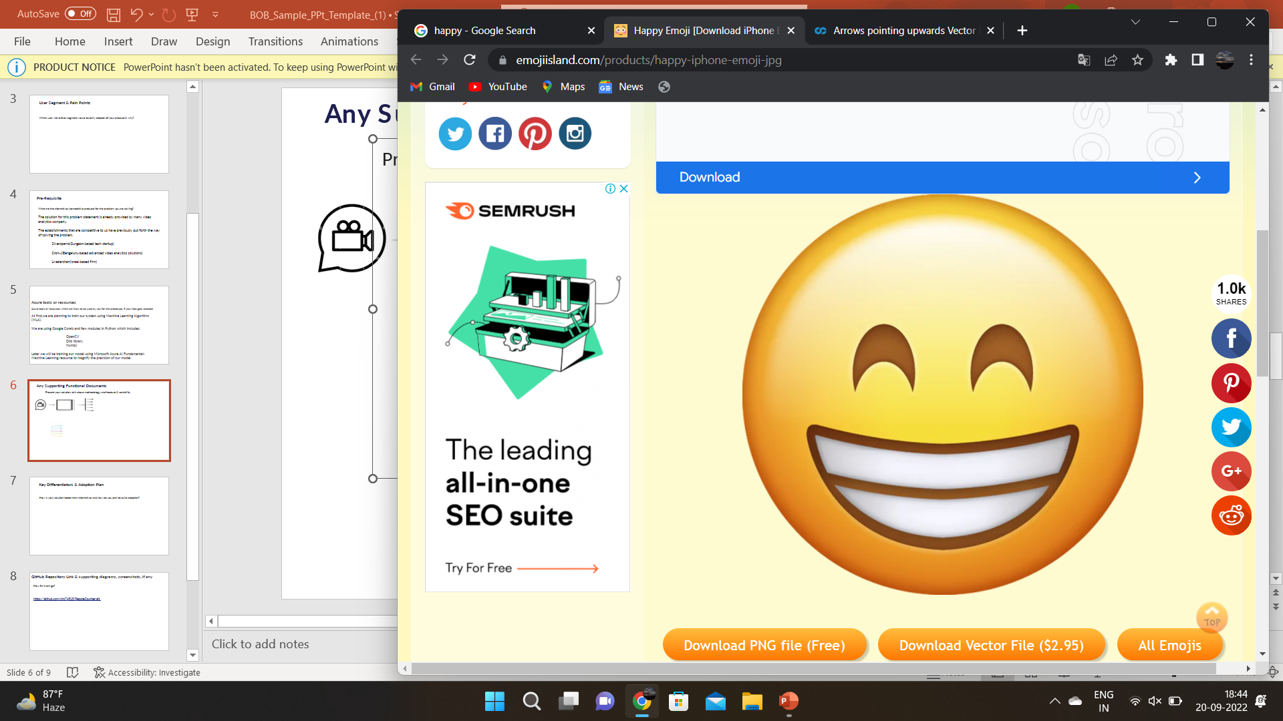
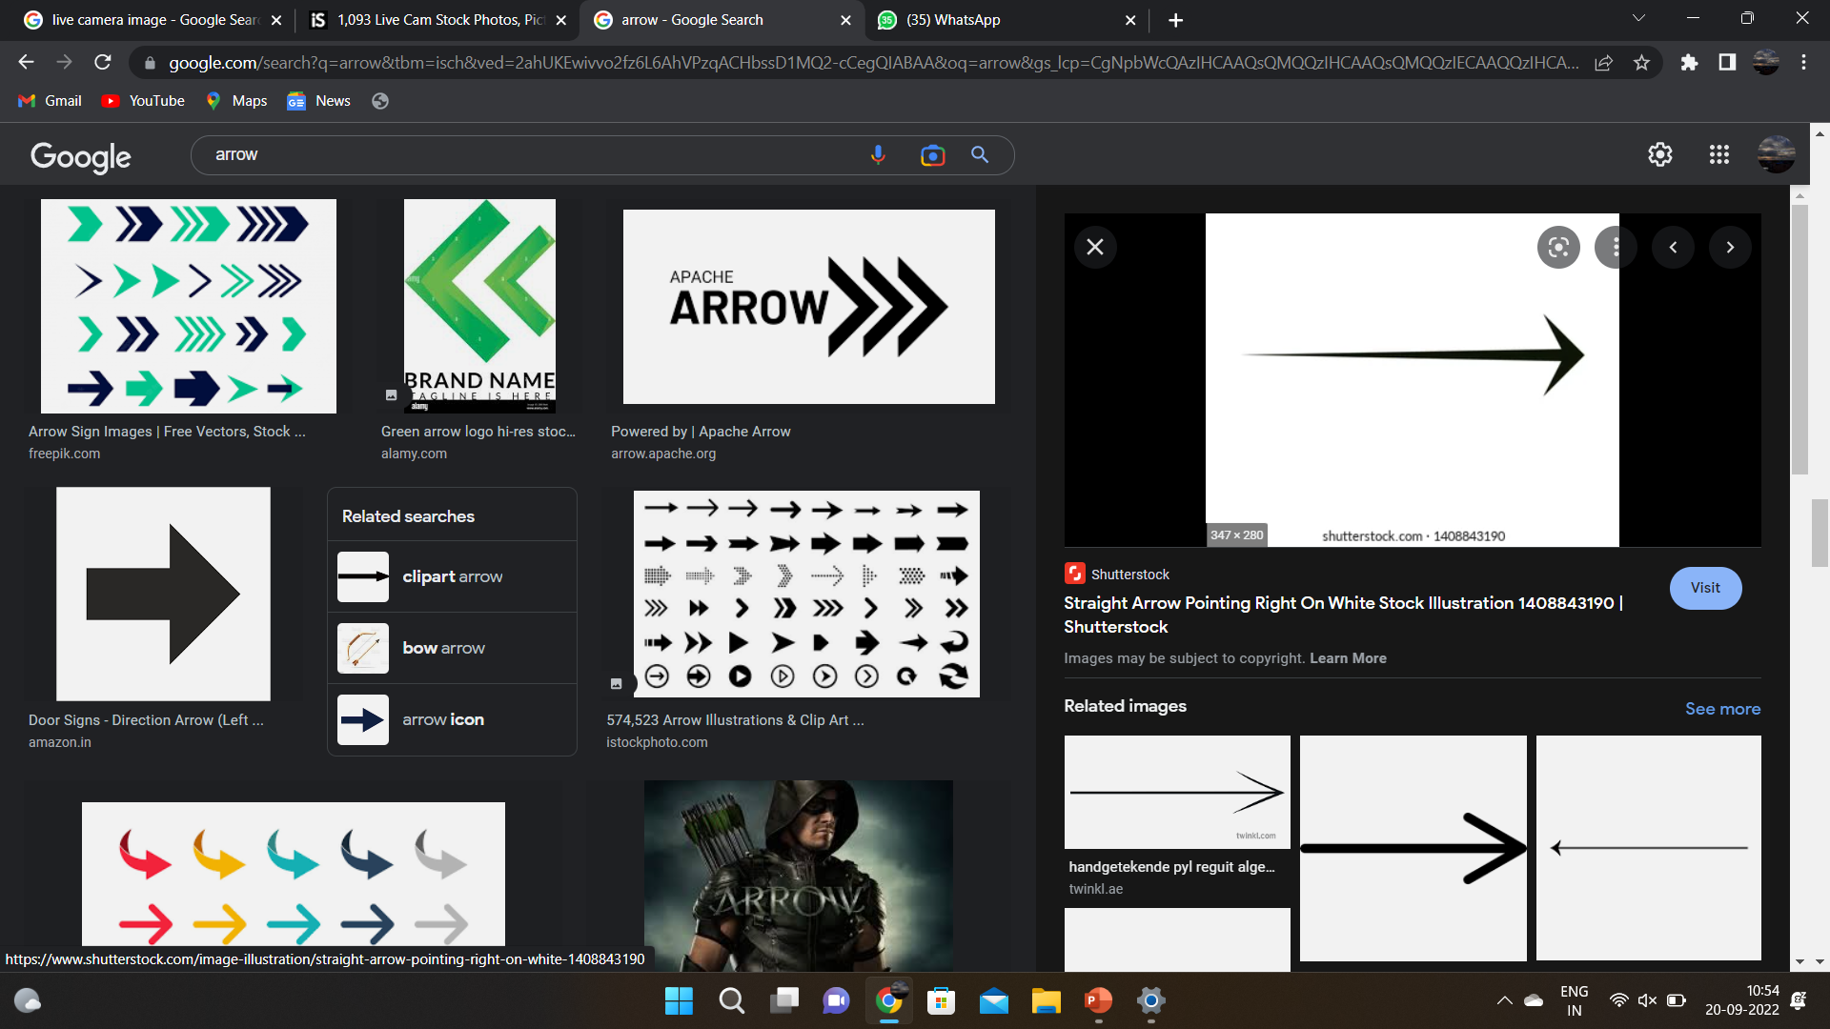
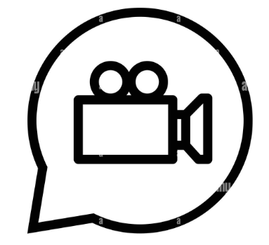
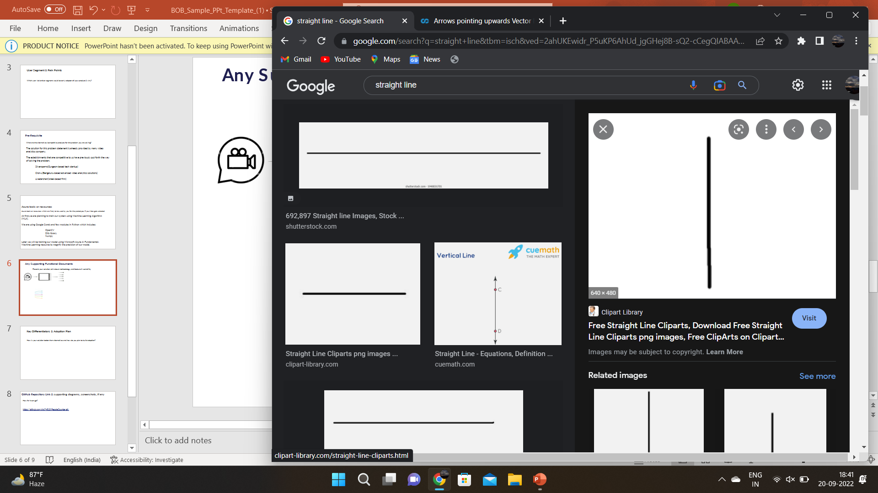
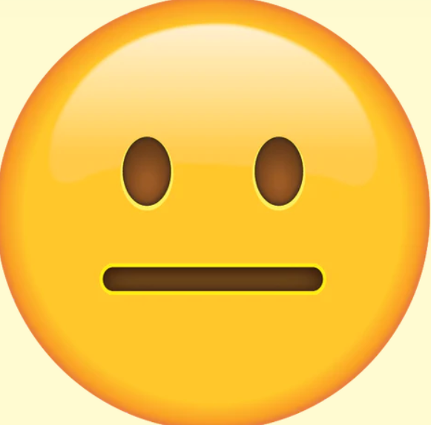
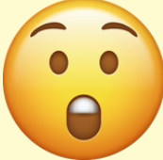
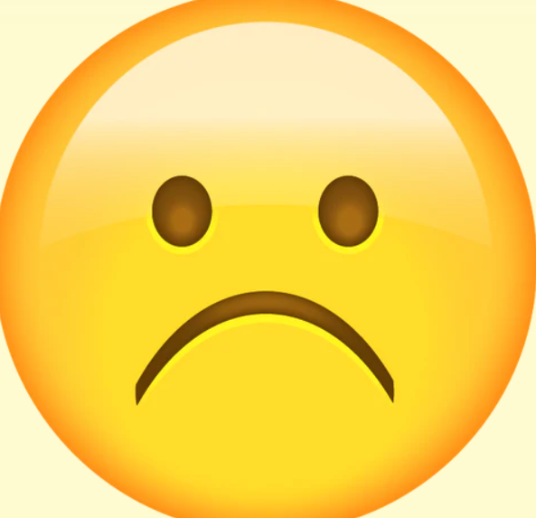
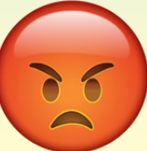
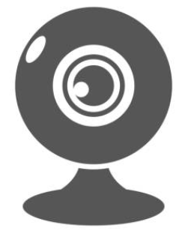
Any Supporting Functional Documents Present your solution, talk about methodology, architecture & scalability
SMILE
TRAINING THE
AI MODEL
NEUTRAL
SURPRISED
SAD
ANGRY
VIDEO
FRAMES
EMOTIONS
OUTPUT
TRAINED AI MODEL
LIVE CAM
VIDEO
FRAMES

Slide 7
Key Differentiators & Adoption Plan How is your solution better than alternatives and how do you plan to build adoption?
When compared to the other solutions our model can be used by all the sectors including banks which uses the surveillance technology.
Our model will be cost efficient than the existing models.
Our model will be more accurate and high in quality.
Our model is more secure so that the third party company cannot access our datas which was the big issue faced by Saas.
Our model gives an accuracy upto 99.99% whereas in AGEITGY is it only 99.38%.

Slide 8
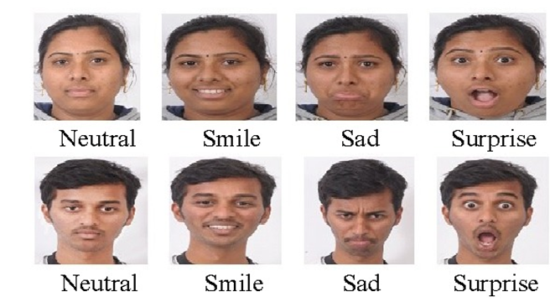
GitHub Repository Link & supporting diagrams, screenshots, if any
How far it can go?
https://github.com/chs74515/PeopleCounter.git
https://github.com/swatijha2496/FACE-RECOGNITION-USING-OPENCV-IN-PYTHON.git
Sample output :

Slide 9
Thank You
MENTOR: Mrs.K.Jaspin,M.E.,(Ph.d).,
Assistant Professor/CSE
Team member names:
VINOTHA S – 21CS1251
VIDHYASRI J – 21CS1228
ZAIBA THABASSUM K – 21CS1273
VASITHRA D – 21CS1113

